Slide 1
Professional Improvement Fund & Sabbatical Grants
Thursday, November 23, 2023
JESSICA THOMAS, SUPERINTENDENT, PEOPLE SERVICES
Allison McCaffrey, President, ATA Local 55

Slide 2
Agenda
Prayer
History
Overview
Grant Criteria
Application
Follow-up
Questions
Notes:
Andrea

Slide 3
Prayer
Lord, in your goodness, you have made us stewards of your gifts and called us in freedom to use them wisely.
We ask you to guide our minds and hearts with your wisdom this day.
May our commitment to growth and learning be a faithful reflection of your son’s gospel message, and to guide us in using our gifts to help others.
We make this prayer to you through Christ our Lord.
Amen
Prayer: Adapted from http://religiouseducation.rccdsb.edu.on.ca/wp-content/uploads/sites/26/2010/06/SchoImpSafeSchools.pdf
Image: https://images.app.goo.gl/FG1dMJntpMmEqWob6
Notes:
Andrea

Slide 4
Territorial Acknowledgement
Notes:
Andrea

Slide 5
History of Professional Improvement Leaves
A review of professional improvement took place and was implemented for the 2016-17 school year. The program continues to be assessed for effectiveness.
Result was to diversify the current sabbatical leaves fund to meet a broader range of approaches to professional learning
Notes:
Andrea

Slide 6
How is the amount for Sabbatical and PIF determined?
0.625 x # of teachers = the district allocation for professional improvement as per the collective agreement:
Equates to approximately $1.5 million in total per annum
50% - sabbatical leaves
50% - PIF
Notes:
Andrea

Slide 7
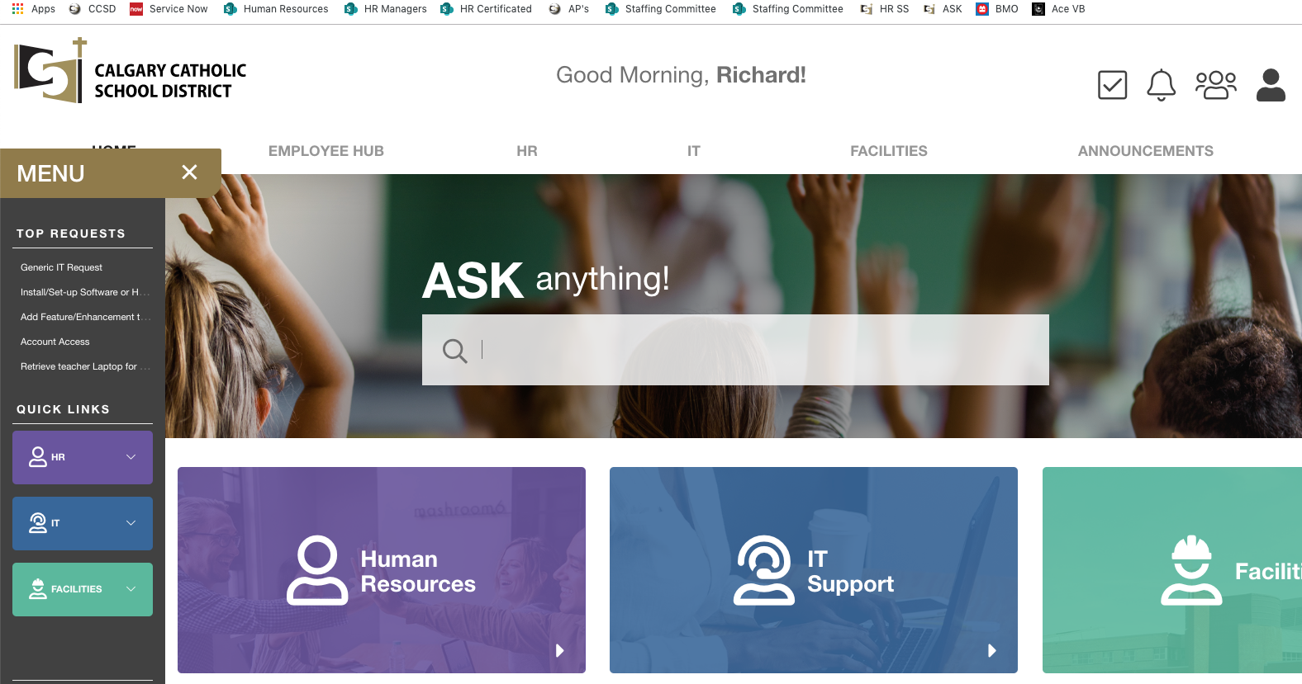
Where can you find information?
On
the intranet
http://www.atalocal55.ca/funding>pif
https://ask.cssd.ab.ca/ssp
Notes:
Andrea

Slide 8
PIF Disposition of Funds - Deadlines
PIF
Grant Period 1: Closes last Friday in September 2023
Up to 50% of the PIF funds available under clause 9.4.
Grant Period 2: Closes last Friday in January 2024
Up to 25% of the PIF funds available (or amounts rolled over) under clause 9.4.
Note: PIF Grants must be used for courses during the 2023-2024 grant year.
Sabbatical
Applications must be submitted to central office on Friday, January 12, 2024 4:00pm
Grant Period 3: Closes last Friday in April 2024
PIF Courses must begin and end within the annual granting period (September 1, 2023 – August 31, 2024)
Interviews will be conducted on Wednesday, January 17, 2024
Up to 25% of the PIF funds available (or amounts rolled over) under clause 9.4
Notes:
Andrea

Slide 9
Professional Improvement Fund Coverage
Types of Fund Coverage under PIF
Tuition reimbursement (most common use of PIF Funds)
Leaves may be requested under exceptional circumstance for which a rationale must be provided (special projects etc.)
Combination of Tuition and Leave
Tuition plus short-term leave which is equivalent to maximum of one day per course enrolled in during the school year. The total maximum possible (between tuitioin and leave costs) is to not exceed $10,000 CAD per traditional school calendar year
Leave ONLY Reimbursement
Notes:
Mario

Slide 10
PIF Tuition Fee Grants
Copy of a course overview including a listing of the program of studies or degree sought, course names, credit values, dates and topics.
Only accredited courses at recognized post-secondary or equivalent institutions will be considered. To be accredited, a course must be transferrable across post-secondary institutes.
Request may be up to $10,000.00 CAD of tuition costs in that granting year.
Tuition requests may be made to either PIF or PGS but not both.
Notes:
Mario

Slide 11
PIF GRANTS ARE CONSIDERED IF THEY...
Cover activities which are responsive to the learning needs of students;
Cover activities which contribute to the professional growth of the teacher
Cover activities which are considered accredited courses at recognized post-secondary or equivalent institutions. Accredited courses must be transferable across post-secondary institutes.
Request may be up to $10,000.00 CAD in one traditional school calendar year (September 1 through August 31st) and may be a combination of tuition and leave grants.
Only one PIF grant in any granting period.
Requests may be made to either PIF or PGS but not both
Notes:
Mario

Slide 12
General Criteria for PIF Application
Employed with the district for a total of 3 years
Will not be on a Sabbatical while utilizing PIF Funds.
Benefit to the students, teacher and district and is considered an accredited course from a post-secondary institute.
Not meant to attend conferences or workshops
Notes:
Mario

Slide 13
SOME MORE DETAILS ON PIF Leave Requests
As a courtesy, each application requiring absence from regular assignment should be discussed with principal and indicate her or his knowledge of the proposed absence for professional development reasons
Typically, leaves are granted equal to one day per course during the school year. Typical use of leave days are to attend approved courses, complete course work, write dissertations and papers etc. If leave requests are for more than one day per course, then special approval/consideration will be required.
Guest teacher costs: $235.03 per full day
Costs associated with lodging, food and travel are not covered under PIF. Longer leaves (that exceed one day per course) will require a full explanation and will be considered by the committee with the final approval at the discretion of the Superintendent of People Services.
Notes:
Mario

Slide 14
Application Tips - PIF
No cohort application – individual must apply separately.
Please detail how your proposal will be applied after you have completed your programming. Please complete the application in its entirety.
Continuity of student programming must be at the forefront and consultation with your Administration is encouraged.
Notes:
Mario

Slide 15
PIF Funding – some final thougts…
Specify
Please specify dates and course numbers (for tuition grants) as best you can or if this information, include the courses with a generic course name (eg.Option 1, Summer Elective 1 etc) and expected tuition costs to ensure you are including ALL potential courses in the year. Once you have confirmation of the correct course number, a “Course Notification of Change” form (found on www.atalocal55.ca or ASK) can be completed and forwarded to your file is accurate.
Calculate
Please calculate the estimated cost of leaves days you might require
$235.03 – per day
Other?
Approved expenses covered by PIF funding are limited to tuition, technology fees and graduate study fees (these must be itemized on the institution’s statement of account.). Fees NOT covered by the PIF fund include: books, student union, campus health, life insurance, infrastructure, interest payments, loan payments, late fees, etc.
Notes:
Mario

Slide 16
Sabbatical Grant Uses
“the teacher will spend the leave in improving professional qualification as a teacher”
2018-2020 collective agreement 9.2.2.1
Generally used to pursue graduate studies
Notes:
Andrea

Slide 17
General Criteria for Sabbaticals
Employed with the district a minimum of 8 years.
Will not be receiving PIF funding during the Sabbatical leave.
Have not received Sabbatical Leave in the previous eight school years.
Leave will not exceed one school year.
Teacher will not engage in remunerative work during the leave.
Notes:
Andrea

Slide 18
Approved Sabbatical Leaves
Receive 70% of gross salary
Do not accrue a pensionable year
Benefits are available but must be purchased
Notes:
Andrea

Slide 19
Application Tip - Tuition
Identify your program and institution
i.e. Masters of Counseling at Gonzaga University
Detail courses you will be taking with proposed dates
Notes:
Mario

Slide 20
Application Tips - Sabbatical
Complete the application thoroughly
Please detail how your proposal will be applied after you have completed your programming
Prepare for your conversation with Superintendent, People Services and ATA President – approx. 20 minutes
How will it benefit you, students and district?
Notes:
Andrea

Slide 21
Reporting and Reimbursement PIF AND SABBATICAL
PIF Funding – complete all that apply
Upon conclusion of each course the following forms need to be submitted. It will be reviewed by the PIF Admin Assistant and forwarded upon approval at:
Tuition: PIF Receipt Tuition Receipt Submission Form
Must include receipt of payment and itemized breakdown of expenses from your institution and transcripts showing successful completion of your course(s)
If course numbers have changed since your original application, please submit PIF Course Change Notification
Leaves: PIF Leave Report Form
Sabbatical grants must submit the successful completion of all course work
Full sabbatical – 8 courses x 3 credits each = 24 credits
Half sabbatical – 4 courses x 3 credits each = 12 credits
Notes:
Andrea

Slide 22
Follow-up Requirements
PIF applicants must not retire or resign for a one-year period from the date of completion
Sabbatical applicants shall not retire or resign for a two-year period from the date of return to work
Within 2 months of completion of PIF programming, please forward the PIF Tuition Receipt form with detailed breakdown of fees and proof of course completion. Please remember to submit for reimbursement once each course is complete and grades are received.
Sabbaticals – must be provided by Jessica
Seek opportunities to share experiences with others in our district
Notes:
Andrea

Slide 23
Questions
Notes:
Andrea and Mario

